Slide 1
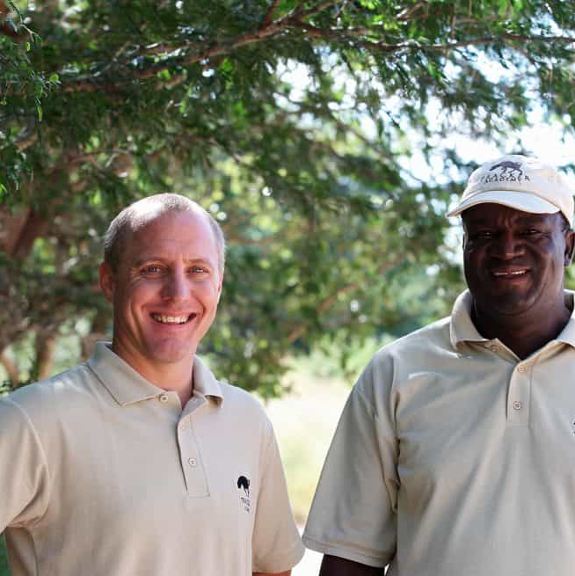
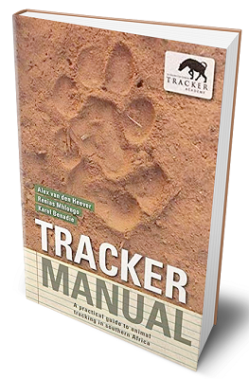
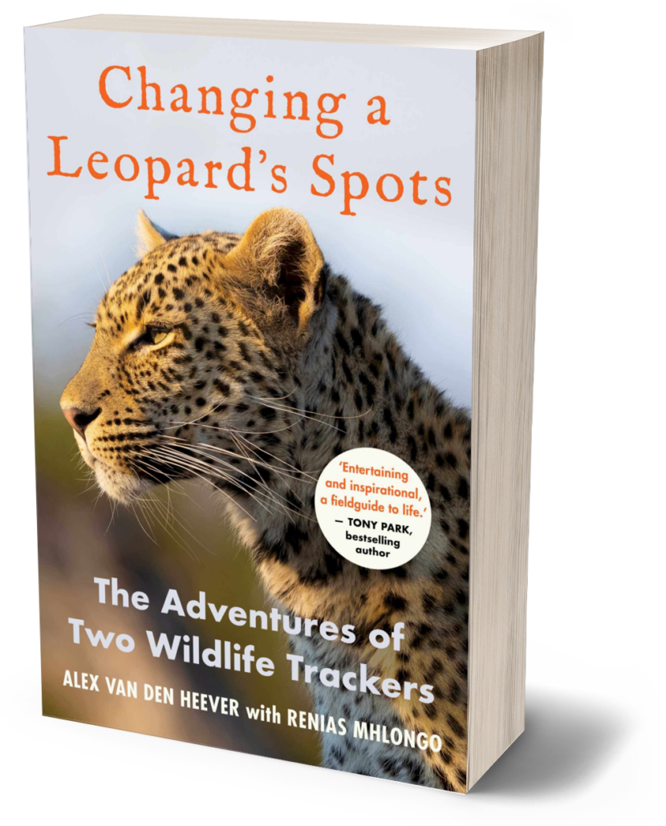
Watch Alex van den Heever and Renias Mhlongo
The Power of Relationships is a totally unique keynote presentation that follows Alex van den Heever and Renias Mhlongo’s 25-year journey working together in the world’s most hostile environments – tracking lions, leopards, grizzly bears, jaguars and wolves.
Audiences learn how to build trust in difficult circumstances, dismantle implicit bias and create a culture of belonging in the workplace.
Following his studies in business management, Alex became the youngest person to ever qualify as a Senior Wildlife Tracker in South Africa.
Alex van den Heever and Renias tell their story of a path to profound mutual understanding. Their story is a tale of contrasts: white and black; man, and boy; apartheid and unity; third world and first world.
Alex uses the real-life story of his life as a game ranger at Londolozi Private Game Reserve and his relationship with tracker Renias Mhlongo to convey transformational wisdom and insights.
They provide the keys to unlock the latent potential of diverse working relationships.
Keynote Topics:
Power of Relationships
Cultural Diversity
Tracking for Success
Alex van den Heever
Inspirational Wildlife Tracker
*Client is responsible for air travel, transfers and accommodation.
**Alex travels from Pietermaritzburg &
***Renias travels from Londolozi Game Reserve, Kruger National Park

