Slide 1
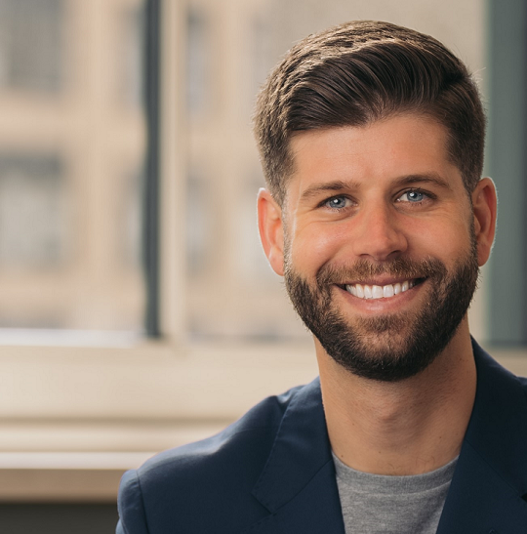
Watch Rob Lawless: Showreel
Create more connected, empathetic, and successful relationships in the workplace and with your clients through the exponential power of human connection.
In 2015, Rob Lawless set out to meet 10,000 people, spending one hour with each person to truly understand their stories.
Rob believes that genuine human connection is something important in today’s world and through his journey, Rob has discovered how the power of intentional connection can unite, connect and empower us in ways far deeper than we ever imagined.
Since embarking on this journey, Rob Lawless has connected with over 5,400 individuals from more than 90 countries worldwide.
He has traveled across the nation six times and has been featured in various prominent media outlets
Rob Lawless is passionate about adventure and potential – throughout the past seven years, he has found that this project embodies both aspects.
Keynote Topic:
Discover the Untapped Value of Human Connection
ROB LAWLESS
Human Values
*Client is responsible for business class, round-trip airfare, ground transportation, hotel accommodations and incidentals for up to two nights

