Slide 1
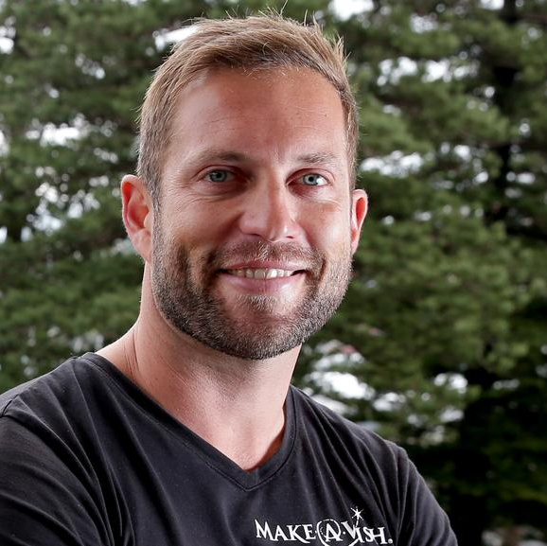
Watch Sebastian Terry
Drawing on his inspirational story of personal loss and the subsequent journey to find purpose in life via his list of 100 things, Sebastian is renowned for delivering action-based messaging that integrates goal setting, striving and accountability as a vehicle for personal and collective evolution.
With his ‘Live Your List’ philosophy turned into a best-selling book, a TV show and a game-changing corporate wellness program, Sebastian’s dynamic storytelling and expert facilitation has helped some of the world’s largest brands support & leverage the personal growth of their employees as a foundational pillar for professional development and organizational health.
Previous clients include; TikTok, Google, Bank of America, McKesson, Merryl Lynch, Hewlett Packard, McDonalds, Cisco, BHP, YMCA, Snap Fitness
Sample Keynote Topics:
Peak Performance & Productivity
Mental Health Keynote Speaker
Inspirational Leadership Keynote Speaker
Culture Keynote Speaker
Employee Engagement Keynote Speaker
Building Culture, the Right Way Up
Sebastian Terry
Founder of 100 Things
*Client is responsible for ground transportation in event city, hotel accommodations and incidentals
for up to two nights
**Travels from Los Angeles

