Slide 1
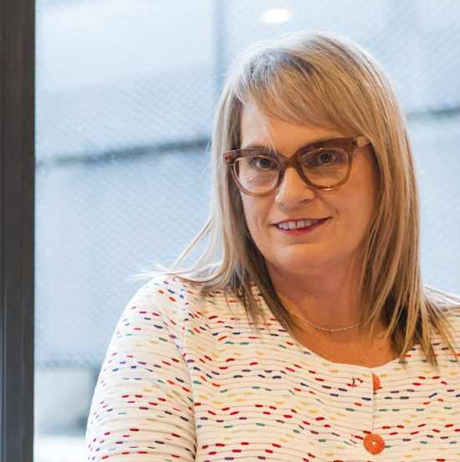
Watch Zelda la Grange
Watch Zelda’s Ted Talk
Zelda la Grange: Talks at Google
Zelda la Grange is an internationally renowned speaker and bestselling author, best known for her 19 years of service as Nelson Mandela’s trusted personal assistant.
From a conservative Afrikaner upbringing to standing beside one of history’s greatest leaders, her life reflects the transformative power of forgiveness and unity.
Through her extraordinary journey, Zelda offers a compelling voice on leadership, reconciliation, and social change. Her story—woven with personal anecdotes from behind the scenes with Mandela—delivers a deeply human message about embracing diversity, ethical leadership, and the courage to change.
Today, she inspires audiences around the world, bringing Mandela’s values to life in every speech. Zelda’s authenticity, warmth, and wisdom leave a lasting impact on every stage she walks onto.
“Reconciliation is a choice. Leadership is a responsibility. Change is possible—for all of us.”
Most Popular Keynote Topics
Lessons from Mandela
  Zelda la Grange’s keynote is a powerful journey through leadership, humility, and transformation—rooted in the profound lessons she learned while working alongside one of history’s greatest statesmen, Nelson Mandela. Drawing from nearly two decades as his trusted aide, Zelda delivers a deeply moving and enlightening narrative that explores what it truly means to lead with integrity, embrace diversity, and foster reconciliation in times of division.
Zelda la Grange
Inspirational Speaker
R43,750
*Client is responsible for round-trip airfare, ground transportation in event city, hotel accommodations and incidentals for up to two nights
**Travels from Cape Town

